Slide 1
Linear Programming Problems
Mathematical Programming
…is the development of modeling and solution procedures which employ mathematical techniques to optimize the goals and objectives of the decision-maker. Programming problems determine the optimal allocation of limited resources to meet certain objectives.

Slide 2
Linear Programming Problems
…are mathematical programming problems where all of the relationships amongst the variables are linear.

Slide 3
Components of a LP Formulation
Decision Variables
Objective Function
Constraints
Non-negativity Conditions

Slide 4
Decision Variables
…represent unknown quantities. The solution for these terms are what we would like to optimize.

Slide 5
Objective Function
…states the goal of the decision-maker. There are two types of objectives:
  Maximization, or
  Minimization

Slide 6
Constraints
…put limitations on the possible solutions of the problem. The availability of limited resources may be expressed as equations or inequalities which rule out certain combinations of variable values as feasible solutions.

Slide 7
Non-negativity Conditions
…are special constraints which require all variables to be either zero or positive.

Slide 8
Special Terms
Parameters
RHS
Objective Coefficients
Technological Coefficients
Canonical Form
Standard Form

Slide 9
EQUATION
OPTIMISE(MAX or MIN)
Z = C1X1+C2X2+C3X3……+CnXn
SUBJECT TO CONSTRAINTS :
a11x1+a12x2+……a1nxn(<,=.>)b1
a21x1+a22x2+…..a2nxn (<,=.>)b2
am1x1+am2x2…+amnxn (<,=.>)bm
and x1,x2….xn>=0

Slide 10
Parameters
…are the constant terms. These are neither variables, nor their coefficients. In canonical form the parameters always appear on the right-hand side of the constraints.

Slide 11
Right-Hand Side (RHS)
…are the numbers (parameters) located on the right-hand side of the constraints. In a production problem these parameters typically indicate the amount, or quantity, of resources available. In the conventional literature these are known as the “b”s.

Slide 12
Objective Coefficients
…are the coefficients of the variables in the objective function. In a production problem these typically represent unit profit or unit cost. In the conventional literature these are known as the “c”s.

Slide 13
Technological Coefficients
…also known as “exchange coefficients,” these are the coefficients of the variables in the constraints. In a production problem these typically represent the unit resource requirements. In the conventional literature these are known as the “a”s.

Slide 14
Canonical Form
…refers to an LP problem with an objective function, all of the variables are non-negative and where all of the variables and their coefficients are on the left-hand sides of the constraints, and all of the parameters are on the right-hand sides of the constraints.

Slide 15
Standard Form
…refers to an LP problem in canonical form. In addition, all of the constraints are expressed as equalities and every variable is represented in the same order of sequence on every line of the linear programming problem.

Slide 16
Formulating Linear Programming Problems
Assume:
  You wish to produce two products (1) Walkman AM/FM/Cassette and (2) Watch-TV
  Walkman takes 4 hours of electronic work and 2 hours assembly
  Watch-TV takes 3 hours electronic work and 1 hour assembly
  There are 240 hours of electronic work time and 100 hours of assembly time available
  Profit on a Walkman is Rs.7; profit on a Watch-TV Rs.5

Slide 17
Formulating
Let:
  X = number of Walkmans
  Y= number of Watch-TVs
Then:
  4X+ 3Y ≤ 240 electronics constraint
  2 X + 1Y≤ 100 assembly constraint
  7X + 5Y = profit maximize profit

Slide 18
Graphical Solution Method
Draw graph with vertical & horizontal axes (1st quadrant only)
Plot constraints as lines, then as planes
  Use (X1,0), (0,X2) for line
Find feasible region
Find optimal solution
  Corner point method
  Iso-profit line method

Slide 19
Graphical LP Solution Procedure
Formulate the LP problem
Plot the constraints on a graph
Identify the feasible solution region
Plot two objective function lines
Determine the direction of improvement
Find the most attractive corner
Determine the coordinates of the MAC
Find the value of the objective function

Slide 20
Shader Electronic Company Problem
Hours Required to
Produce 1 Unit
Department
X₁
Y_{Y}
Available Hours
Walkmans
Watch-TV’s
This Week
Electronic
4
3
240
Assembly
2
1
100
Profit/unit
Rs.7
Rs.5
Constraints:
4x + 3y ≤ 240 (Hours of Electronic Time)
2x+ 1y ≤ 100 (Hours of Assembly Time)
Objective:
Maximize: 7x₁ + 5x₂

Slide 21
Shader Electronic Company Constraints
Electronics
(Constraint A)
120
100
Assembly
(Constraint B)
80
Number of Watch-TVs (X₂)
60
40
20
0
0
10
20
30
40
50
60
70
80
Number of Walkmans (X₁)

Slide 22
Shader Electronic Company Feasible Region
Electronics
(Constraint A)
120
100
Assembly
(Constraint B)
80
Number of Watch-TVs (X₂)
60
40
Feasible
Region
20
0
0
10
20
30
40
50
60
70
80
Number of Walkmans (X₁)

Slide 23
Shader Electronic Company Solution
Corner Point Solution
Electronics
(Constraint A)
Assembly
(Constraint B)
120
100
80
Possible Corner Point Solution
Number of Watch-TVs (Y)
60
Optimal solution
40
20
0
0
10
20
30
40
50
60
70
80
Number of Walkmans (X)

Slide 24
PROBLEMS
Q2.Product A and B can be manufactured by company which gives profit of Rs 5 per unit and Rs 7 per unit respectively. Each unit of A consumes 5kg of raw material and each unit of B consumes 3 machines hours. Total raw material available is 30Kg while total machine hour available is 18hr. Obtain the optimal product mix for profit maximization.
Q3. A firm manufactured two products A and B on which the profit earn per unit are Rs 3 and Rs 4 respectively .Each product is processed in two machines M1 and M2.Product A requires one hour processing time on machine M1 and two hours in M2 while product B requires one hour on M1 and one hour on M2. If machine M1 is available for not more than 7hr 30minutes while machine M2 is available for 10 hrs during any working day. Find the no. of units of product A and B to be manufactured to get the maximum profit.

Slide 25
Q4. A manufacturer intends to market a new fertilizer produced from a mixture of 2 ingredients A and B . The composition of the ingredients is as follows;
Compositions
Ingredients | Bonemetal | Nitrogen | Lime | Phosphate
A B | 20% 40% | 30% 15% | 40% 40% | 10% 5%
The management decision is such that the fertilizer.
1).must e sold in bags of 20Kgs. 2) must contain at least 25% Bonemetal
3) must contain at least 15% Nitrogen 4) must contain at least 10% Phosphate.
Cost of ingredients is Rs. 20/per Kg for A and Rs 16 /-per kg for B.
Write the LP Formulation for the quantities of ingredients to be mixed to minimize the material cost.

Slide 26
Redwood Furniture Company
Resource | Unit Requirements |  | Amount Available
 | Table | Chair
Wood | 30 | 20 | 300
Labor | 5 | 10 | 110
Unit Profit | 6 | 8

Slide 27
Redwood Problem Formulation
Let: X_{T} = number of tables produced
X_{C} = number of chairs produced
MAX Z = 6 X_{T} + 8 X_{C}
s.t. 30 X_{T} + 20 X_{C} < 300
5 X_{T} + 10 X_{C} < 110
where: X_{T}, X_{C} > 0

Slide 28
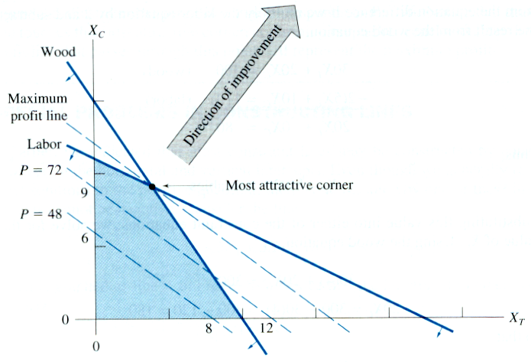
Redwood Furniture Problem
  X_{T} = 4 tables
  X_{C} = 9 chairs
  P = 6(4) + 8(9) = 96 dollars

Slide 29
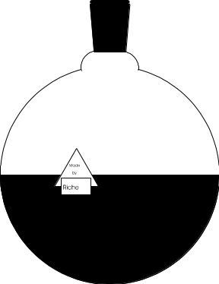
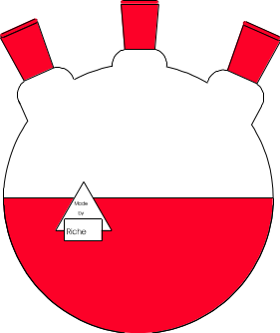
Minimization Example
You’re an analyst for a division of Kodak, which makes BW & color chemicals. At least 30 tons of BW and at least 20 tons of color must be made each month. The total chemicals made must be at least 60 tons. How many tons of each chemical should be made to minimize costs?
BW: Rs.2,500 manufacturing cost per month
© 1995 Corel Corp.
Color: Rs. 3,000 manufacturing cost per month

Slide 30
Formulation of Solution
Decision variables
  X₁ = tons of BW chemical produced
  X₂ = tons of color chemical produced
Objective
  Minimize Z = 2500X₁ + 3000X₂
Constraints
  X₁ ≥ 30 (BW); X₂ ≥ 20 (Color)
  X₁ + X₂ ≥ 60 (Total tonnage)
  X₁ ≥ 0; X₂ ≥ 0 (Non-negativity)

Slide 31
Graphical Solution
80
Find values for
X₁ + X₂  60.
X₁ ≥ 30, X₂ ≥ 20.
BW
60
Total
Feasible
Region
Tons, Color Chemical (X₂)
40
20
Color
0
0
20
40
60
80
Tons, BW Chemical (X₁)

Slide 32
Optimal Solution:
Corner Point Method
80
Find corner points.
BW
60
Total
Feasible
Region
Tons, Color Chemical
40
B
20
Color
A
0
0
20
40
60
80
Tons, BW Chemical

Slide 33
Exercises:
Use the graphical solution procedure to determine the optimal solutions for the following linear programming problems. For each, show the feasible solution region, the direction of improvement, the most attractive corner, and solve for the decision variables and the objective function.

Slide 34
Problem #1
  MIN Z = 3A – 2B
  s.t. 5A + 5B > 25
  3A < 30
  6B < 18
  3A + 9B < 36
  where: A, B > 0
A = 2
B = 3
Z = 0

Slide 35
Problem #2
  MAX Z = 6X – 3Y
  s.t. 2X + 2Y < 20
  6X > 12
  4Y > 4
  4X + Y < 20
  where: X, Y > 0, where x and y are integers
X = 19/4
Y = 1
Z = 51/2

Slide 36
Problem #3
  MAX Z = 5S – 5T
  s.t. 3T < 18
  4S + 4T < 40
  2S < 14
  6S - 15T < 30
  3S > 9
  where: S, T > 0
S = 7
T = 4/5
Z = 31

Slide 37
Special LP Cases
For each of the following problems use the graphical solution procedure to try to determine the optimal solutions. You may find it difficult to proceed in some cases, and in all cases the results are interesting. In each case proceed as far as you can.

Slide 38
Special Case #1
  MAX Z = 4X₁ + 3X₂
  s.t. 5X₁ + 5X₂ < 25
  X₂ > 6
  X₂ < 8
  where: X₁, X₂ > 0
INFEASIBLE Problem

Slide 39
Special Case #2
  MAX Z = 4X₁ + 3X₂
  s.t. 5X₁ + 5X₂ > 25
  X₂ < 6
  X₂ < 8
  where: X₁, X₂ > 0
Redundant Constraint
UNBOUNDED Problem

Slide 40
Special Case #3
X₁= 3
X₂ = 2
Z = 20
  MAX Z = 4X₁ + 4X₂
  s.t. 5X₁ + 5X₂ < 25
  X₂ < 4
  X₁ < 3
  where: X₁, X₂ > 0
X₁= 1
X₂ = 4
Z = 20
Multiple Optimal Solutions

Slide 41
Problem# 1
1. A firm produces three products. These products are processed on three different machines . The time required to manufacture one unit of each of three products and the daily capacity of the three machines are given below.
Machine |  |  |  | Machine Capacity ( Minutes /Day)
 | Product 1 | Product 2 | Product 3
M1 | 2 | 3 | 2 | 440
M2 | 4 | - | 3 | 470
M3 | 2 | 5 | - | 430
It is required to determine the daily number of units to be manufactured for each product. The profit per unit for product 1,2,3 is Rs 4, Rs 3 and Rs 6 respectively. It is assumed that all the amounts produced are consumed in the market. Formulate the mathematical (L.P) model that will maximize the daily profit.

Slide 42
Problem # 2
A Manufacturer of cylindrical containers receives tin sheets in widths of 30 cm and 60 cm respectively. For these containers the sheets are to be cut to three different widths of 15cm, 21 cm, and 27 cm respectively. The number of containers to be manufactured from these three widths are 400, 200 and 300 respectively. The bottom plates and top covers of the containers are purchased directly from the market. There is no. limit on the lengths of standard tin sheets. Formulate the L.P. model for the production schedule that minimizes the trim losses.

Slide 43
Problem # 3
Acme Widgets produces four products: A, B, C and D. Each unit of product A requires 2 hours of milling, one hour of assembly and $2 worth of in-process inventory. Each unit of product B requires one hour of milling, 3 hours of assembly and $5 worth of in-process inventory. Each unit of product C requires 2 1/2 hours of milling, 3 1/2 hours of assembly and $4 worth of in-process inventory. Finally, each unit of product D requires 5 hours of milling, no assembly time and $16 worth of in-process inventory. The firm has 1,200 hours of milling time and 1,300 hours of assembly time available. Each unit of product A returns a profit of $40; each unit of B has a profit of $36; each unit of product C has a profit of $24; and each unit of product D has a profit of $48. Not more than 120 units of product A can be sold and not more than 96 units of product C can be sold. Any number of units of products B and D may be sold. However, at least 100 units of product D must be produced and sold to satisfy a contract requirement. It is otherwise assumed that whatever is produced can be sold. Formulate the above as a linear programming problem to maximize profits to the firm.

Slide 44
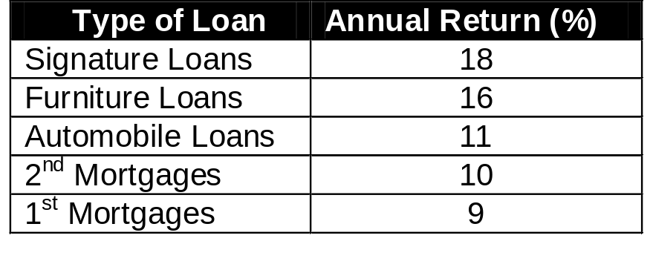
Problem #4
The Thrifty Loan Company is planning its operations for the next year. The company makes five types of loans. The loans are listed along with the annual return on the loans:
Legal requirements and company policy place the following limits upon the various types of loans:
Signature loans cannot exceed 10% of the total amount of loans. The amount of signature and furniture loans together cannot exceed 20% of the total amount of loans. First mortgages must be at least 40% of the total mortgages and at least 20% of the total amount of loans. Second mortgages may not exceed 25% of the total amount of loans. The firm can lend a maximum of $1.5 million.
Formulate the above as a linear programming problem to maximize the revenues from loans.

Slide 45
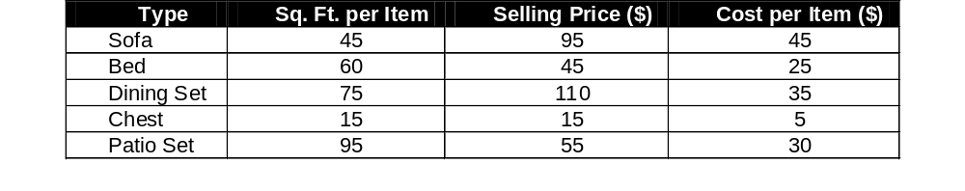
Problem #5
Roscoe owns a used furniture store. He has 500 square feet of floor space available for new purchases. The following pieces of furniture are available to him:
Roscoe does not want to stock more sofas than beds. For each patio set stocked he wants to have at least one of everything else. He has $450 allocated for these purchases. Formulate the above as a linear programming problem to maximize Joe's profit from his purchases.

Slide 46
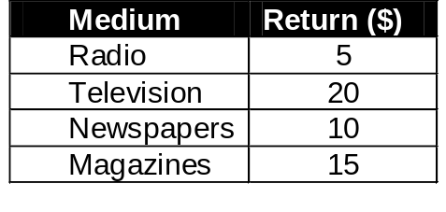
Problem #6
The marketing department for Omni World Enterprises would like to allocate next year's advertising budget among the various media to maximize the return to the firm. The year's expenditures for advertising are not to exceed $2 million, with not more than $1.1 million spent during the first six months. The media used are newspapers, magazines, radio and television. Spending on the different media is restricted by the following company policies:
  At least $200,000 is to be spent on newspapers and magazines combined in each half of the year.
  At most, 80% of the advertising expenditures are to be spent on television in each six-month period.
  At least $50,000 is to be spent on radio for the year.
  At least 25% of the advertising expenditures on television are to be spent in the second six-month period.
Returns from a dollar spent on advertising in each medium are as follows:
Formulate a linear programming problem for Omni's advertising budget.

Slide 47
Question # 4
A company manufactures two products A and B . The profit per unit of A and B is Rs 60/- and Rs 80/- respectively. The company is required to supply 200 units of product A to its regular customers. Product A requires machining on machine M1 only and per unit of A, one hour of M1 is required. Product B requires machine M2 only ad machine hours on M2 has enough hours to available to manufacture any number of units of product B. M1 has 400 hours available .Product A and B both require one labour hour each and company has 500 labour hours available. To determine the number of units of A and B to be manufactured , satisfying given condition conditions . Formulate the LPP.(UOP-Nov. 03)

Slide 48
Question # 5
A firm produces three products . The products are processed in three different machines . The time required to manufacture one unit of each of the three products and daily capacity of the three machines are given in the table below.
It is required to determine the daily number of units to be produced for each product. The profit per unit for product 1,2 and 3 is Rs 4,Rs 3 and Rs 6 respectively. It is assumed that all the amounts produced are consumed in the market . Formulate LPP.(UOP-99)
Machine | Time per unit (Minutes)
 | Product 1 | Product 2 | Product 3 | Machine Capacity(Minutes per day)
M1 | 2 | 3 | 2 | 440
M2 | 4 | -- | 3 | 470
M3 | 2 | 5 | -- | 430

Slide 49
Question # 6
A firm produces three products A , B and C. It is uses 2 raw materials I and II of which 5000 and 7500 units can be used for production of A,B and C . Product A requires 3 units of raw material I and 5 units of raw material II per unit. Corresponding requirement per unit of B are 4 and 3 units of raw material I and II respectively and per unit of C ,5 units of I and 5 units of raw material II. The labour time to produce 1 unit of A is twice required to produce 1 unit of B and is three times required to produce 1 unit of C. The entire labour force of firm can produce equivalent of 3000 units of product A. The minimum demand for 3 products is 600,650 and 500 units respectively. Assuming profits per unit of A,B and C are Rs 50, Rs 60 and Rs 80 respectively. Formulate the LPP to maximize the profit satisfying constraints.
(UOP-05)

Slide 50
Question # 7
A company has two grades of inspectors I and II who are to be assigned for a quality control inspection. It is required that at least 2000 pieces t be inspected per 8 hrs day. Grade I inspector can check at the rate of 50 per hour with an accuracy of 97% . Grade II inspector can check pieces at the rate 40 per hour with an accuracy of 95% . The wage rate of Grade I inspector is Rs 4.50/hr and that of grade II is Rs 2.50/hr. Each time an error is made by an inspector the cost to the company is one rupee. The company has available for the inspection job 10 grade I and 5 grade II inspectors. Formulate the LPP to find how many grade I and II inspectors to be engaged to minimize the total cost.(UOP May 05)

Slide 51
Question # 8
The owner of winner sports wishes to determine the number of advertisements to be placed in the three selected magazines A,B and C . His objective is to advertise in such a way that the total exposure to the principal buyers of the expensive sports goods is maximized. Percentage of readers of each magazines are known . Exposure in any particular magazine is the number of advertisements placed multiplied by the number of principal buyers. The following data may be used.
The budget amount at most is Rs 1 lakh for the advertisements . The owner has already decided that magazines A will have no more than 6 advertisements and B and C each have at least 2 advertisements . Formulate LPP for the problem.(UOP- Dec 03,08)
 | Magazines
 | A | B | C
Readers | 1 lakh | 0.6lakh | 0.4lakh
Principal Buyers | 15% | 15% | 7%
Cost/Advt.(Rs) | 5,000 | 4,500 | 4,250

